Slide 1
Year 6 SATs Information
Notes:
1

Slide 2
The Big Picture
Children are formally assessed against national expectations at the end of Key Stage 2 (Year 6).
We aim to keep SATs in proportion with our broad and balanced curriculum – they should NOT be a stressful experience.
Notes:
2

Slide 3
Scores
Children receive:
- A raw score for each test:
how many marks they got in the test
- A scaled score, converted from their raw score.
Scaled score of 100 = national expectation
- Confirmation of whether or not they attained the national standard.
All children sit the same tests. This means that the tests have a mixture of easier and more difficult questions, and the children are encouraged to attempt as much as they are able to.
Notes:
3

Slide 4
Scores
Standardised Scores explained:
80 is the lowest possible score and 120 is the highest.
A score of 100 means the child is working 'at the expected standard' (EXP) for a Year 6 child.
A score of 99 or less means they haven't reached the government's 'expected standard' and are working towards it (WT)
A score of 110 or more means that the child is working at ‘greater depth’ (GD)
Notes:
4

Slide 5
Timetable for SATs 13^{th _} 16th May 2024
Mon 13th | Tues 14th | Weds 15th | Thurs 16th
Grammar & punctuation | Reading Comprehension | Maths Paper 1 Arithmetic | Maths Paper 3 Reasoning
Spelling |  | Maths Paper 2 Reasoning
Notes:
5

Slide 6
SPaG Tests
SPaG stands for Spelling, Punctuation and Grammar
Punctuation and grammar paper – 45 minutes
Spelling Test – 20 words, read out by teacher (approx. 20 minutes)
Notes:
6

Slide 7
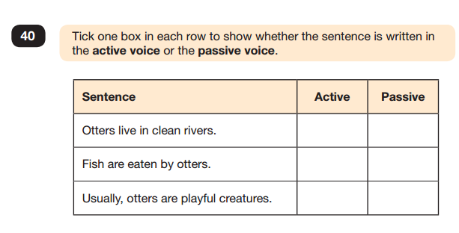

Slide 8
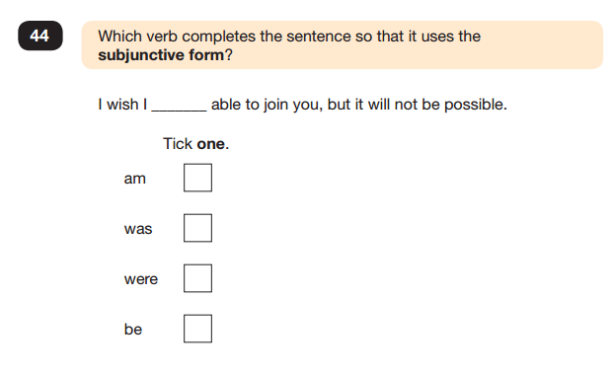

Slide 9
Reading test
Pupils are given one hour for the reading test.
The test will include three or four unrelated texts
- past examples include stories, poems, explanations, interviews and reports.
Most of the questions will require the children to make inferences and deductions to show they really understand the text.
There are some simpler fact-finding questions too.
Notes:
9

Slide 10
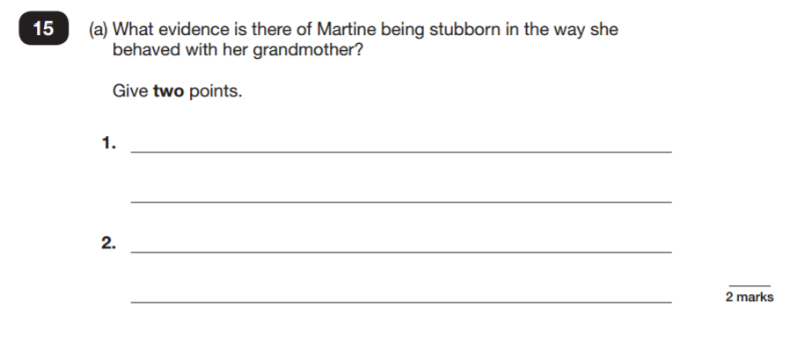

Slide 12
Writing
There is no writing test.
Children’s writing is assessed through continuous teacher assessment throughout the year.
Writing assessment is based on children’s use of:
punctuation and grammatically-correct writing
using different sentence structures
writing a well-organised piece of work
spelling and handwriting
Notes:
12

Slide 13
Maths Tests
There are three maths tests:
Paper 1– Arithmetic
- 30 minutes
- This test focuses on children’s ability to calculate using written methods.
Papers 2 and 3 – Reasoning
- Both 40 minutes
- The reasoning papers test children’s ability to apply their mathematical skills to problem-solving questions.
Notes:
13

Slide 14
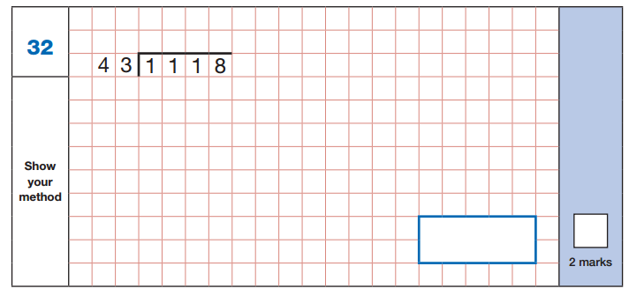
Arithmetic

Slide 15
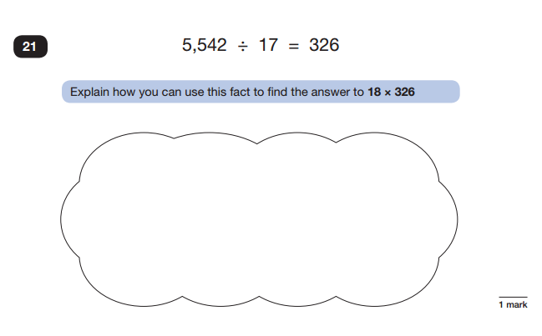
Reasoning

Slide 16
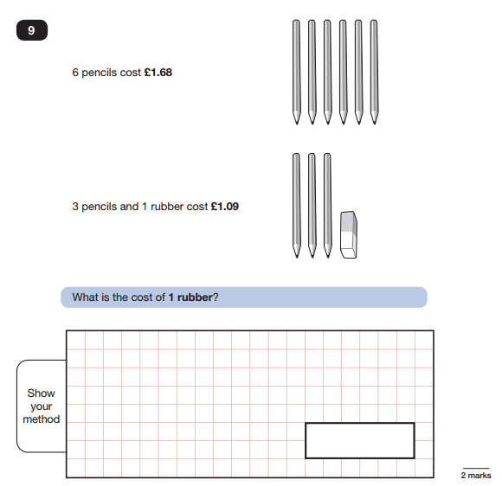
Reasoning

Slide 17
SATs Club
We will be running an optional early morning SATs Club where children can further develop their understanding and practise their skills
Wednesday and Friday mornings from 8:15

Slide 18
How are we supporting your children?
Arithmetic, writing or SPAG start each morning (arriving on time is important).
Regular opportunities to write across a range of genres; weekly regular comprehension and SPaG practice.
Using test-style questions to help familiarise children with the format of the SATs papers.
Maintaining a positive and Growth Mindset approach
Notes:
18

Slide 19
How can you support your child?
Help children develop normal routines at home (bedtimes, mealtimes, exercise and homework – don’t let them stay up late on phones or computers!)
Stay positive and encouraging
Daily reading, spellings and/or times tables practice
Set aside time regularly for the Google Classroom weekly reading question and Chilli Challenge homework.
Try your very best to not put the children under unnecessary pressure; all we want them to do is try their best.
Notes:
19

Slide 20
After the Tests (to be confirmed)
Results will be sent back to school towards the beginning of July.
The test results and a teacher assessment is reported to the children’s secondary school and to parents (end of year reports).
Tests indicate what a child can do on ONE day, the teacher assessment gives a picture of a child’s ability over time.
Notes:
20

Slide 21
Thank you for your continued support.
Please do not hesitate to contact us if you have any questions or concerns.
Notes:
21

